Slide 1

10 Easy Ways to Engage Students

Slide 2

Engaging Students
What the main barrier to using more engaging techniques than lecture?
What assumptions underlie that barrier?
What is the best alternative to that assumption?

Slide 3
Engaging Students
Assumptions:
Teaching = Telling
Listening = Learning
Alternate assumption:
Doing = Learning

Slide 4

Engaging Students
Notes:
The odds are against us becoming the most engaging teacher with a straight lecture
20 years of research

Slide 5
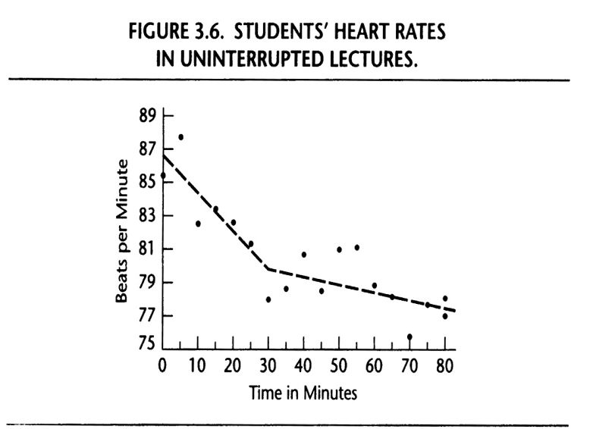
Engaging Students
Your Heart’s Reaction to Lectures
(Bligh, D. A. [2000]. What’s the use of lectures? San Francisco: Jossey-Bass.)

Slide 6
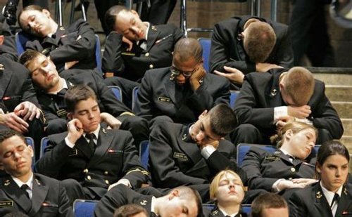

Slide 7
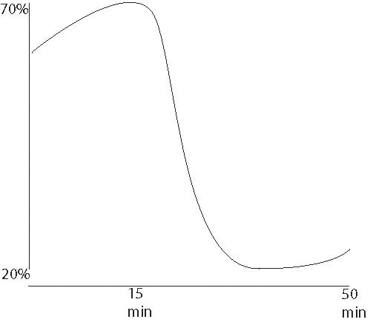
Engaging Students
Medical Students Retention from Lectures
(Stuart, J. & Rutherford, R.J. (1978.) Medical student concentration during medical lectures. Lancet 2: 514-516. )

Slide 8

Engaging Students
Banker-Teacher Model
  How much do teachers talk?
    85% of class time
  When teachers are challenged…
Fischer & Grant, 1983; Lewis, 1982; Nunn, 1996; Smith, 1983

Slide 9

Engaging Students
The fable of the pitcher and the glass
Notes:
“But,” you say, “I have to cover the material.”
In a land before time, in a school not far from this one, there was a pitcher of information that was trying to teach a glass.

Slide 10
Engaging Students
What’s the moral of the story for learning?
Notes:
Naturally, the pitcher wanted to share as much of its wisdom as possible…

Slide 11
Engaging Students
What is learning?
It’s not what’s poured from the pitcher, but what lands in the glass.

Slide 12

Engaging Students
A 6,000 student study of teaching physics via passive lecture v. active learning

Slide 13
Engaging Students
Learning Gain
Interactive
Traditional
Hake 1998
Notes:
In this 6,000 student study, Hake (1998) found that the students of those who taught with interactive approaches made twice the average gain in learning, which was more by two standard deviations.

Slide 14
10 Ways to Engage Students
Easy
Always
1. Maintain sustained eye contact.
2. Ask before you tell.
3. Create a structure for note-taking.
4. Let your readings share the lectern.
Never Fail to
Hold Students Accountable Daily
5. Quiz daily.
6. Use “clickers.”
7. Call on a student every 2-3
minutes.
Sometimes
8. Use the pause procedure.
9. Assign one-minute papers.
10. Try Think-Pair-Share.

Slide 15
Always
Maintain sustained eye contact.
Ask before you tell.
Create a structure for note-taking.
Let your readings share the lectern.

Slide 16


1. Maintain sustained eye contact
Maintain sustained rather than fleeting eye contact.
Maintain eye contact
throughout a whole
sentence.
Don’t flit around.

Slide 17


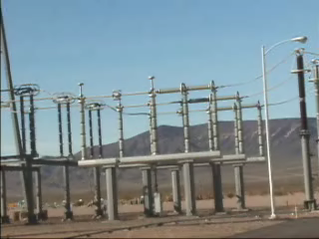
1. Maintain sustained eye contact
Eye contact=electric current (keeps audience plugged in).
Don’t disconnect for more than ten seconds.
Hoff, 155

Slide 18

1. Maintain sustained eye contact
Eye contact can do more to improve your delivery than any other single improvement.
Hoff, 117–118

Slide 19

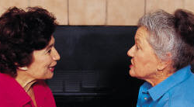
Maintain eye contact skillfully
Let’s try it
Work in groups of three
When you are the speaker:
Talk about your own experience with trying to engage students.
Experiment with good principles of eye contact.

Slide 20
2. Ask before you tell
Let students reason things out—or even guess—before you tell them.
Ask them first.
  Focuses student attention on the subject and raises interest in it.
  Helps students learn by connecting what they are learning to what they already know.

Slide 21

2. Ask before you tell
Let’s try it:
Is it better for student learning to have:
Students take their own notes.
Professors pass out complete notes.
Professors pass out incomplete notes.

Slide 22
3. Create a structure for note-taking
?
Same
Different
?
?
2
2
2
(a+b) = a + 2ab + b
Notes:
What could be included in incomplete notes?
Organizational framework
Plotted graphs, but leave labeling the axis to the student
Diagrams, but leave the labeling to the student
Partially completed calculations
Unanswered questions

Slide 23

4. Let your readings share the lectern
Readings have advantages over lecture…
  Less passive
  Easier to stop and review
  Extend time on task
Many students don’t read
  Many readings are
  too difficult
  How can readings
  better serve learning?

Slide 24
4. Let your readings share the lectern
Readings should be carefully chosen for your students
  Level of detail
  Reading level
  Momentum
Type up lecture notes?

Slide 25
4. Let your readings share the lectern
Early in Tara’s career. . .
  What do you look for in your readings?
  How closely does it mirror what your students want?
  Have you asked your students to help you select readings?

Slide 26

4. Let your readings share the lectern
Even with better readings…
Students require a reason to read
  Focus
    Study questions
  Accountability (as discussed
  later)
Let your fingers do the walking…
Let your readings do the talking

Slide 27
Never fail…
to Hold Students Accountable Daily

Slide 28

Never fail…
to Hold Students Accountable Daily
Lecture courses punctuated by three tests have a…
Problem:
Frequency of studying is related to frequency of testing and both are related to time on task.

Slide 29
Never fail…
to Hold Students Accountable Daily
Doubles learning
2X
Menges, 1988

Slide 30
Never fail…
to Hold Students Accountable Daily
5. Quiz daily.
6. Use “clickers.”
7. Call on a student every 2-3 minutes.

Slide 31
5. Quiz daily
Quiz
One ?
Problem/ Short answer
Changes tone of class
Notes:
A quiz can be:
Just one question at the end of class or the beginning (or both with “clickers.”)
A problem or a short answer or multiple choice question
Changes the tone of class

Slide 32
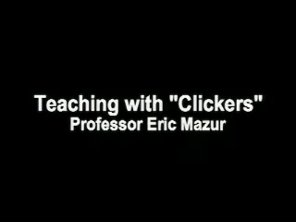
6. Use “clickers”

Slide 33
6. Use “clickers” or “colored cards”
“Colored cards”
    Anonymous
    Simultaneous
A
T
B
F
C
D

Slide 34
7. Call on a student every 2–3 minutes
“Deck of Cards”
  Call on 20 students per fifty minute period
  Call on 2-3 students per question
Frequently shuffle the cards
Modern Languages
  A story
Student Name
Major?
Pic?

Slide 35
Sometimes…
8. Use the pause procedure.
9. Assign one-minute papers.
10. Try Think-Pair-Share.

Slide 36

8. Use the pause procedure
Pause for 2 minutes, three times in a 50-minute period
Allow students to work in pairs to rework notes with no interaction with teacher
Control and experimental groups
were given the same five lectures,
with experimentals doing better on tests by up to 17 percent
Ruhl, Hughes & Schloss, 1987, Teacher Education and Special Education, 10(1): 14–18

Slide 37

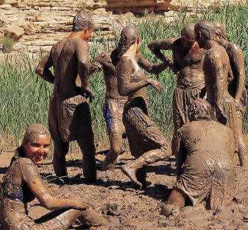
9. Assign one-minute papers
Asks students to write for one minute on questions such as:
  What was the most important thing you learned during this class?
  What important question remains unanswered?
  What was the muddiest point?
Usually done at the end of the hour.
Notes:
How many of you use one-minute papers?

Slide 38

9. Assign one-minute papers
Next class period (or immediately afterwards), close the feedback loop:
  Respond to the papers
  Tell how your lecture was
  changed as a result

Slide 39

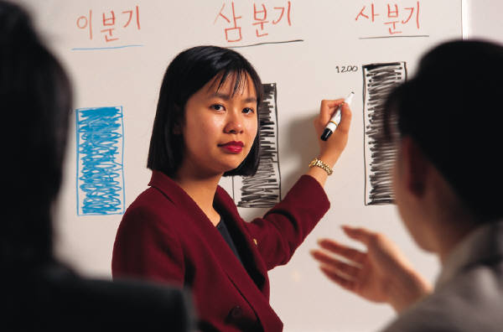

10. Use Think-Pair-Share
Ask a question or make a statement
  THINK: Students think (or write)
  PAIR: Discuss in pairs
  SHARE: Discuss with teacher
Notes:
How many of you use Think-Pair-Share?

Slide 40
10. Use Think-Pair-Share
Let’s try it:
What’s one thing you could do differently to better engage students in class?
  THINK: Students think (or write)
  PAIR: Discuss in pairs
  SHARE: Discuss with teacher
Notes:
How many of you use Think-Pair-Share?

Slide 41
Other Events
Build it and They Will Come: What Worked at NMSU’s Teaching Academy
  4-5 today, Procrastinator Theatre
  9-10:30 tomorrow, SUB 235
Publish & Flourish: Become a Prolific Scholar
  1:30-2:30 tomorrow, SUB 235

Slide 42
10 Easy Ways to Engage Students

