Slide 1
EELE 461/561 – Digital System Design
Module #4 – Interconnect Construction (Printed Circuit Boards)
Topics
Printed Circuit Board Construction
Printed Circuit Board Design
Textbook Reading Assignments
-
What you should be able to do after this module
Describe the fabrication process of a PCB
Design a printed circuit board using modern CAD tools
Understand the signal integrity issues associated with PCBs
Design controlled impedance transmission lines using PCBs
Understand the fabrication limitations of PCBs and how they dictate design rules

Slide 2
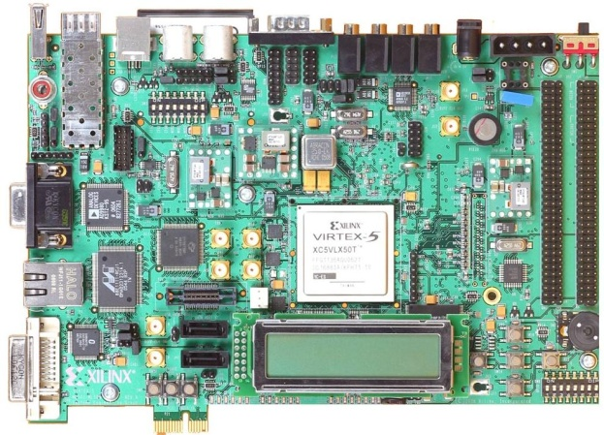
Printed Circuit Boards
Interconnect (PCBs) - we have examined how parasitics along a Transmission Line can lead to reflections and risetime degradation. - now we look at one of the interconnect technologies that is used in modern digital systems. - by understanding the manufacturing steps used to create an interconnect, we can understand: 1) where the electrical parasitics come from 2) manufacturing limits for Cost vs. Performance trade-offs
Printed Circuit Boards - a structure that: 1) mechanically support components 2) provides electrical conduction paths between circuits

Slide 3
Printed Circuit Boards
Terminology “PCB” = Printed Circuit Board (i.e., a “board”) “PWB” = Printed Wiring Board (same as PCB) “PCA” = PCB Assembly, a PCB that is loaded with components “Fab” = the process of creating the PCB “Load” = the process of attaching the components to the PCB

Slide 4
Printed Circuit Boards
Construction - there are a variety of methods to create a PCB. - the general approach is to start with a sheet of copper attached to an insulator and then remove copper leaving only your desired interconnect pattern. - this is called a subtractive method and is the most common technique. - we’ll first go over all of the major process steps used in creating a PCB. 1) The CORE 2) Patterning 3) Vias 4) Pattern Plating
5) Solder Mask
6) Surface Finish
7) Silk Screening - then we’ll put them together in the appropriate sequence from start to finish.

Slide 5
PCB: Core
The CORE - the base element to a PCB is called the “CORE” - this typically consists of two sheets of thin copper laminated (or glued) to an insulating material. - the insulator is commonly call the “Substrate” or the “Laminate” - this construction is also called a “Copper Clad” insulator - COREs come in large sheets which are typically ~18” x 24” (but can be as large as 24” x 48”)

Slide 6
PCB: Core
The CORE CORE Conductors - the most commonly used conducting material is Copper (Cu) - the thickness of the copper sheet is specified in terms of its weight: 2oz = 70 um = 0.0024” The term “weight” refers to the weight in 1oz = 35 um = 0.0012” ounces per square foot” 0.5oz = 17.5 um = 0.0006” 0.25oz = 8.75 um = 0.0003” We sometimes call this sheet a “foil”

Slide 7
PCB: Core
The CORE CORE Insulators - there are many different types of insulating material, each with varying degrees of: - Cost - Dielectric Constants - Electrical Performance (i.e,. Disipation factor = loss tangent) - Mechanical Robustness (rigidity, peel-strength, CTE) - COREs are typically reinforced with a weave of fiber - FR4 (Fire Retardant Epoxy #4) is the most common dielectric in use today.

Slide 8
PCB: Patterning
Patterning - there are 2 common techniques to remove material from the core to leave only the desired conduction paths. 1) Photoengraving / Photolithography - a photomask is created by printing a design pattern onto a translucent material. - this is very similar to printing an overhead transparency using a laser printer. - the CORE is then covered in a photosensitive material (photosensitive dry film, or photoresist). - when the photosensitive material is exposed to light, its properties change.

Slide 9
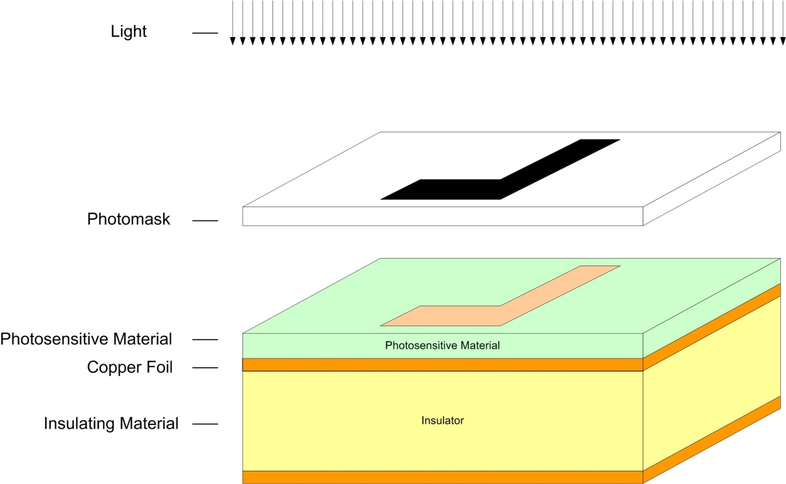
PCB: Patterning
Patterning 1) Photoengraving / Photolithography cont… - the CORE is exposed to a light source through the photomask - a solution is then applied that develops the photosensitive material making is soluble.

Slide 10
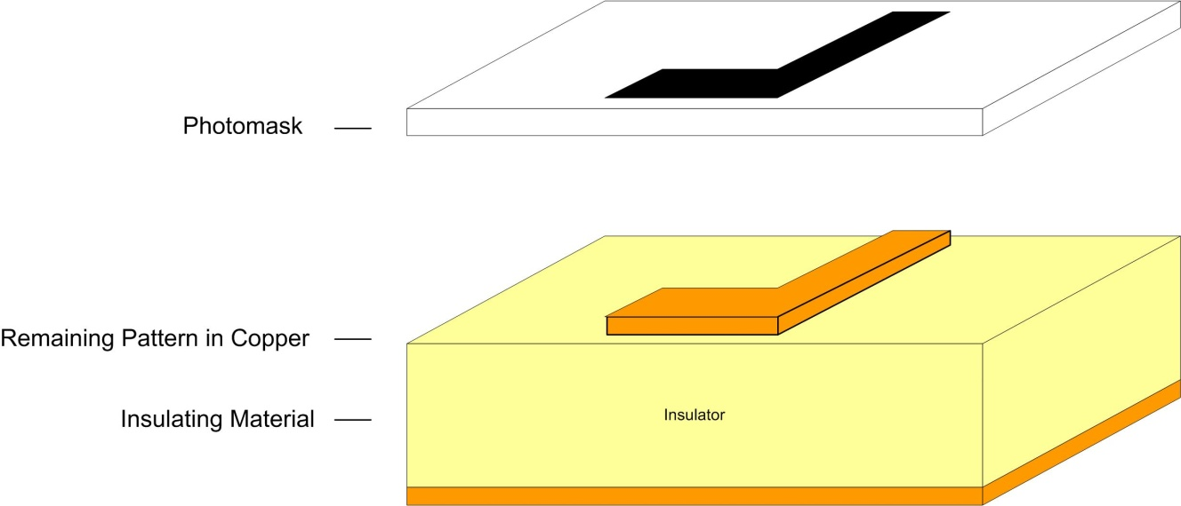
PCB: Patterning
Patterning 1) Photoengraving / Photolithography cont… - an etching solution is then applied to the CORE which removes the “now soluble” photosensitive material in addition to the copper foil beneath it. - this etching step removes any copper on the CORE that was exposed to light through the photomask, thus transferring the pattern. - once the remaining photosensitive material is stripped using a cleaning solution, the CORE is left with a pattern of copper identical to the pattern on the photomask.

Slide 11
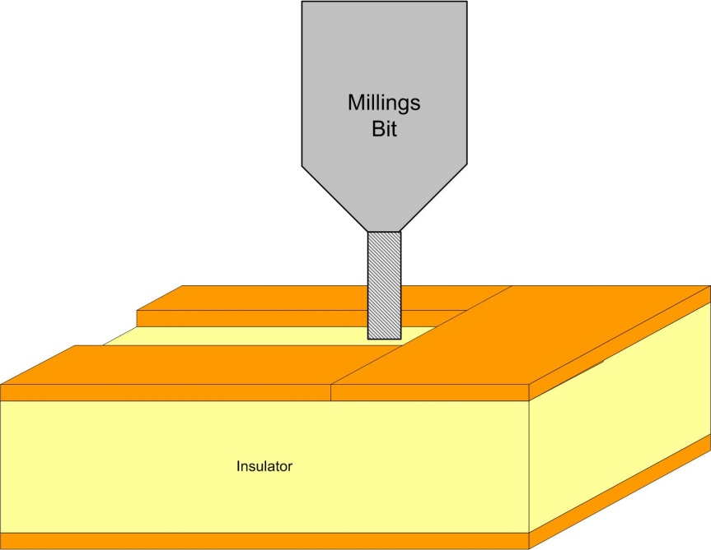
PCB: Patterning
Patterning 2) PCB Milling - another subtractive technique is to use a a milling bit (similar to a router or drill bit) to mechanically remove copper from the CORE leaving only the desired pattern. - we have one of these machines at MSU.

Slide 12
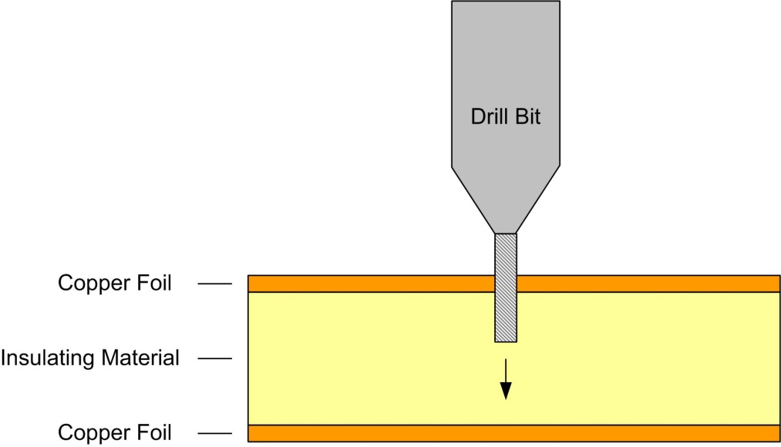
PCB: Vias
Vias (Drilling) - A via is a structure that electrically connects two different layers of copper in a PCB. - the first step in creating a via is to drill a hole where the contact will be made. - this can be done using: 1) A mechanical process (i.e., a regular drill bit). This is currently the most common approach. or 2) A laser (for very small holes)

Slide 13
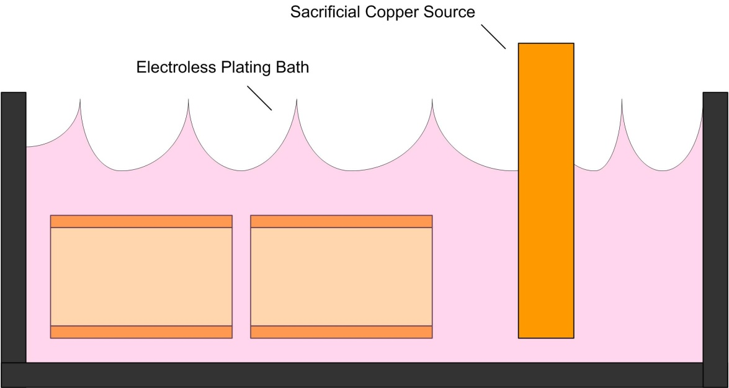
PCB: Vias
Vias (Electroless Plating) - The next step in creating a via is to deposit Copper into the holes in order to Plate the inner diameter of the via with a conducting material. - PCB Via plating is accomplished by an Electroless Plating Process in which a series of chemical reactions are performed to transfer copper atoms from a Sacrificial Copper Source to the barrels of the via holes.
NOTE: “Electroplating” is where the metal source is ionized and drawn to the target using an electric field. “Electroless Plating” uses a chemical reaction to release hydrogen from the target in order to create a negative charge and attract the plating metal to its surface.

Slide 14
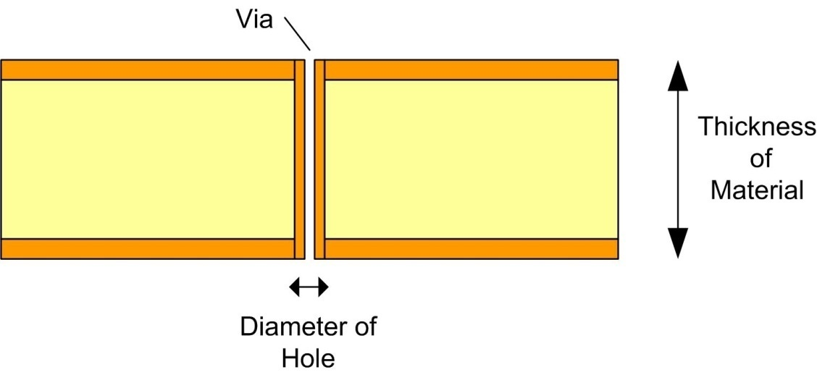
PCB: Vias
Vias - The end result is a structure that connects different layers of a PCB. - The “via” is also called a “Plated Through Hole”
NOTE: The Aspect Ratio is the ratio of the Thickness of the Hole (or Depth) to be plated to the Diameter of the Hole. If the aspect ratio is too large (i.e., deep & skinny holes), then the copper plating will not reach the center of the hole and result in an open circuit.
PCB fab shops will specify the maximum aspect ratio they can achieve (typically ~4-6)

Slide 15
PCB: Pattern Plating
Pattern Plating - the copper deposited from the Electroless Plating step applies a thin layer of copper on the entire surface of the CORE in addition to inside the drilled via holes. - the plating in the via barrels is typically not thick enough (i.e., <0.001") to be reliable. To address this, a second Electrochemical plating is performed. - pattern plating deposits a material over the copper circuitry that will protect it during a subsequent etch stage. A material such as tin can be used to cover the copper traces to protect them. - the copper is first thickened using an additional Electrochemical plating process. - once applied, the tin is deposited on the pattern. - after the etch, the tin can be stripped off or left on depending on the manufacturer.

Slide 16
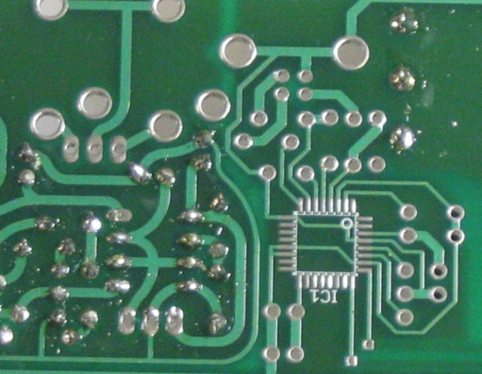
PCB: Solder Mask
Solder Mask - solder mask is a protective insulating layer that goes over the outer sides of the PCB. NOTE: this is typically the green material you see on boards. - copper is very susceptible to oxidation so if the pattern is going to be exposed to ambient air, they need to receive additional plating to protect against oxidation. - oxidation is the reaction of oxygen with the copper. During this process, the copper is actually consumed. So a thin layer of copper can actually be completely oxidized into an insulator. - solder mask is a layer of polymer that can be applied using either silk screening or a spray. - the solder mask covers all conducting circuits on the board with the exception of any pads that components will connect to. NOTE: The word “pad” has special meaning in PCBs. It indicates that a shape of metal: 1) will be used to connect to a component 2) will not be covered by solder mask 3) will receive a surface finish (next step) 4) will receive a layer of solder paste prior to component loading (later)

Slide 17
PCB: Surface Finish / Solder Coat
Surface Finish - also referred to as Solder Coat or Exposed Conductor Plating - the pads of a board must receive a special surface finish to: 1) resist oxidation from long periods of storage while waiting for loading 2) prepare them for the application of solder - to accomplish this, a layer of conducting material is applied to the pads after solder masking. Ex) Tin-Lead Solder (industry is trying to move to “lead free” plating) Gold Silver (Lead-Free compliant, ROHS) - this step is what gives the pads on the board the shiny look that you see

Slide 18
PCB: Silkscreen
Silk screening - silk screening is the process of adding documentation to the board. - the term silk screen refers to the process of transferring a pattern using a special stencil. - a stencil is a sheet of material that has physical openings in it that represent the pattern to be transferred. - in a silk screen stencil, the openings are typically a set of small dots (i.e., a screen) - the stencil is laid on top of the board and then a documentation material is applied to the entire board using a roller & squeegee or spray. - when the stencil is removed, the documentation material remains in the pattern of the openings on the stencil. - the board is then baked to harden the documentation material.

Slide 19
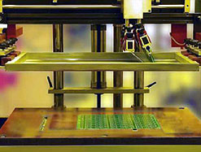
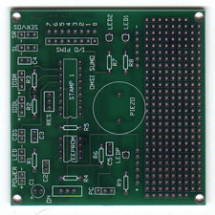
PCB: Silkscreen
Silk screening - you typically cannot draw silk screen lines that are smaller than the copper due to the resolution of the screening process. - when looking at how small of a line can be drawn using a silk screen, manufacturers typically talk about LPI (lines per inch). In general, the smallest silk screen lines are ~0.008”
silk screen machine patterns remaining after silk screen
Applicator & squeegee
Silk screen stencil
Board to receive the silk screen

Slide 20
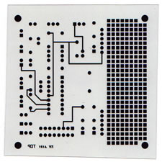
2 Layer PCB Example
Step 1 – Photomask - we create our design in a CAD tool (i.e., Mentor PADS) which generates files to create a photomask
Step 2 – Material Selection - we now select a core that meets our application needs (Dk, loss tangent, copper weight, etc…) - this core will be used to create our PCB.
NOTE: 2 Layer Example Images from PCBexpress.com

Slide 21
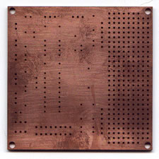
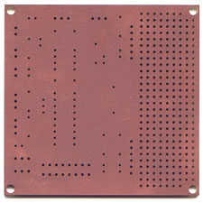
2 Layer PCB Example
Step 3 – Drilling - we now drill through holes where vias are going to be located.
Step 4 – Electroless Plating of Vias - we now put the board through an Electroless plating process which deposits copper inside of the via drill holes.

Slide 22
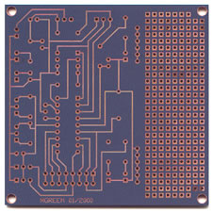
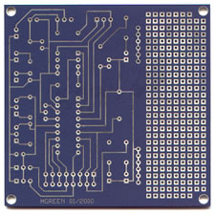
2 Layer PCB Example
Step 5 – Apply Pattern - we now transfer the pattern from our photomask to the core by: - applying photosensitive film (photo resist) to the CORE. - align photomask to the CORE - expose to UV light which changes the properties of the exposed photo resist - apply developing solution to make the exposed photoresist soluble
Step 6 – Pattern Plating - since the current copper patterns are going to be on the outer sides of the board, they require additional steps to ensure that oxidation doesn’t completely consume the metal. - the board undergoes an additional electrochemical plating step that adds additional copper to the existing copper traces and via barrels. - a layer of tin is then added to the surface to protect the copper from the ensuing etch.

Slide 23
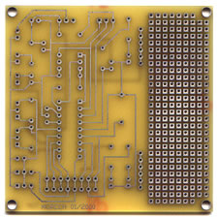
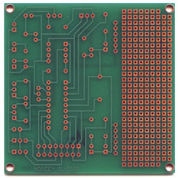
2 Layer PCB Example
Step 7 – Strip & Etch - we now strip the photo resist layer off of the core exposing the unwanted copper. - an etch is performed which removes all of the unwanted copper. - the copper circuitry is protected by the tin and remains after the etch.
Step 8 – Solder mask - an insulating layer of solder mask is applied to the core. - the solder mask covers all of the conductors with the exception of any pads that are to be used to connect to components. - this layer provides protection against inadvertent shorting of the conductors.

Slide 24
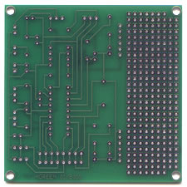
2 Layer PCB Example
Step 9 – Surface Finish - the pads that are visible through the solder mask will ultimately make contact to components using solder. - In order to prepare the pads for the components, a layer of material is applied to the pads that: - is easily soldered to (i.e., Solder, Gold, or Silver) - that prevents any oxidation on the pads so that the board can be stored while waiting for load.
Step 10 – Silk Screen - documentation is now added to the board using a silk screen material. - documentation is important for: - board identification - component locators - component orientations

Slide 25
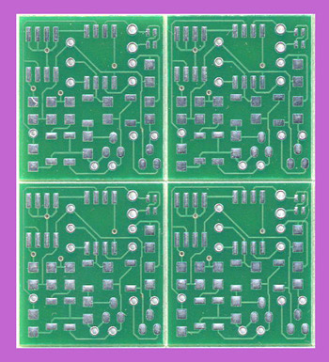
2 Layer PCB Example
Step 11 – De-Panelization - typically, multiple images of the same PCB are put on one panel for processing. - this allows the previously described process steps to create multiple boards in the same amount of time. - the last step is to de-panelize, or route out the individual boards. NOTE: Some automated loading processes can load the boards while still panelized.

Slide 26
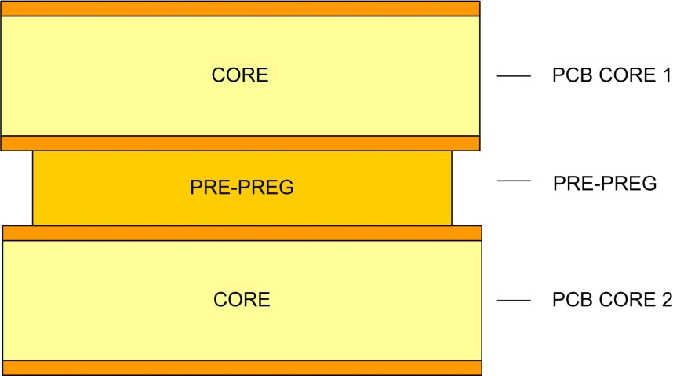
Multi Layer PCBs
Multi Layer PCBs - the same set of steps can be used to create PCB’s with more than 2 layers. - in this case, multiple cores are patterned and then laminated together using an insulator material called a pre-preg - the pre-preg serves as an insulator but has an adhesive property to it that glues the cores together. - the pre-preg material can be the same insulating material as the core. NOTE: this construction process is why boards always come with an EVEN number of layers (i.e., 2 layer, 4 layer, 6 layer, 8,…) Multi Layer PCB

Slide 27
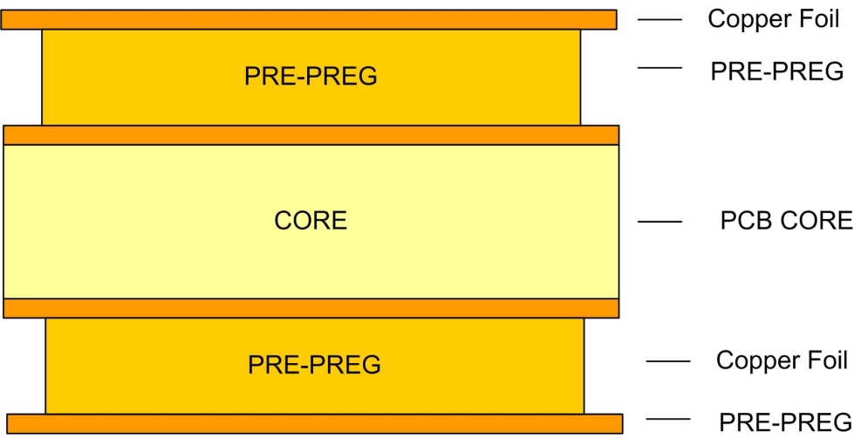
Multi Layer PCBs
Multi Layer PCBs - the resultant stack of layers is called a “stackup” - outer layers can be added to the stack by applying a pre-preg to the core and then laminating a copper foil on top of it. - the entire stack (core + pre-pregs) are put into a press. - the press applies pressure and temperature in order to bond the materials together into one rigid assembly. 4 Layer PCB

Slide 28
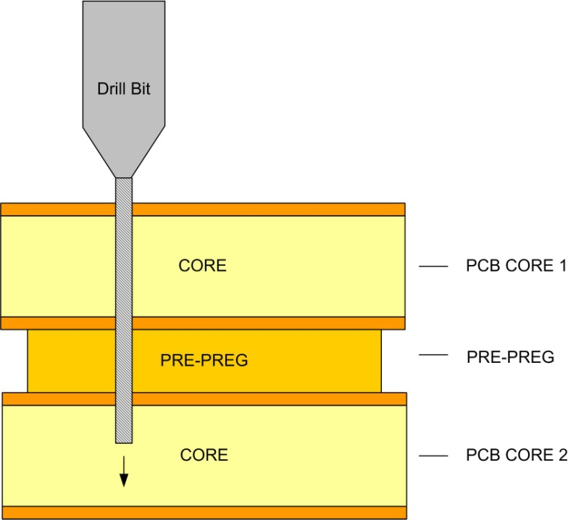
Multi Layer PCBs
Multi Layer PCBs - creating multi-layer PCBs involves some changes to the fabrication process. 1) Drilling occurs after the final lamination takes place. 2) The inner layer traces are patterned prior to drilling and lamination and DO NOT need to undergo the pattern plating and surface finish step. - notice that the through-hole vias will extend through the entire thickness of the board even if the desired connectivity is between the top two layers.

Slide 29
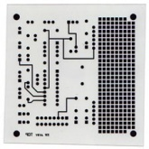
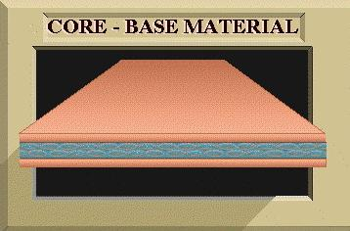
4 Layer PCB Example
Step 1 – Photomask - we need to create photo masks for each layer in the design. - for a 4 layer board, we need to have photo masks for each of the 4 metal layers in addition to misc layers (silk, mask, etc.. more on this later)
Step 2 – Material Selection - for a 4 layer board, we will use one CORE for the inner layers and then laminate foils to the top and bottom to form the outer layers.
NOTE: 4 Layer Example Images from www.jlc.net

Slide 30
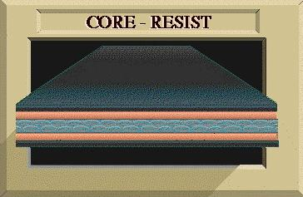
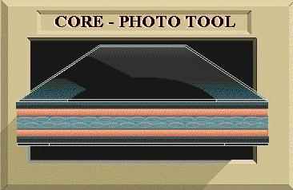
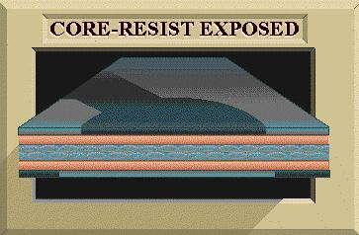
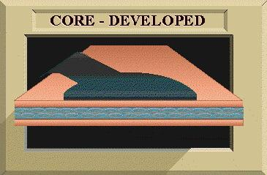
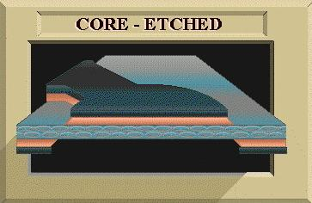
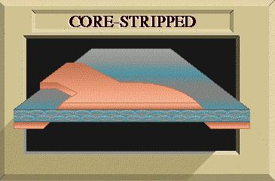
4 Layer PCB Example
Step 3 – Inner Layer Patterning - we now fully pattern the inner layers of the PCB. - this step is slightly different from a 2 layer PCB because these traces will not be on the outside of the board so they aren’t susceptible to oxidation (i.e., no need for pattern plating). - in addition, since there will no components contacting these layers, there is no need for a surface finish or solder mask.

Slide 31
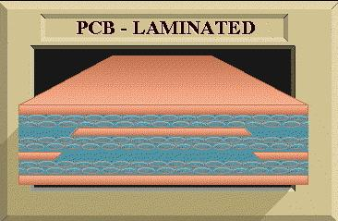
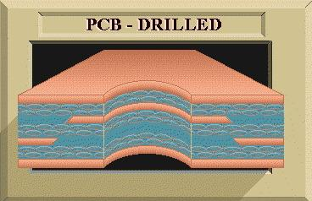
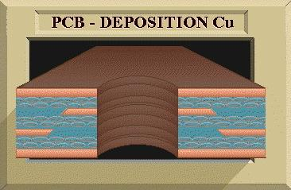
4 Layer PCB Example
Step 4 – Lamination - now a pre-preg material is applied to both sides of the CORE and foil is laminated on both sides. - this stack is put into a press to apply pressure and temperature in order to bond the foils to the CORE.
Step 5 – Through Hole Drillings - the entire stack is drilled.
Step 6 – Electroless Plating of Vias - the drill holes are then plated with copper using an Electroless plating process.

Slide 32
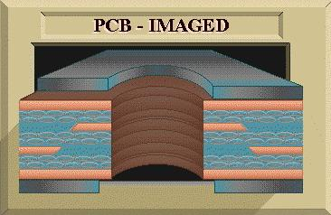
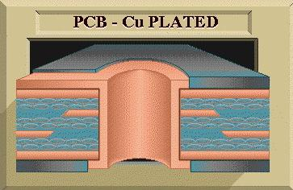
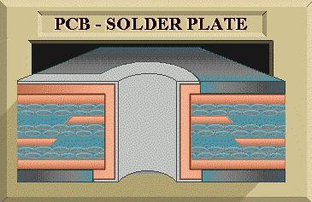
4 Layer PCB Example
Step 7 – Apply Pattern - the outer layers are now coated with photoresist and the pattern is transferred using the outer layer photo masks.
Step 8 – Pattern Plating - the board undergoes an additional electrochemical plating step that adds additional copper to the existing copper traces and via plating. - a layer of tin (or solder) is then added to the surface to protect the copper from the ensuing etch.

Slide 33
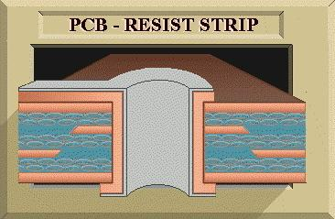
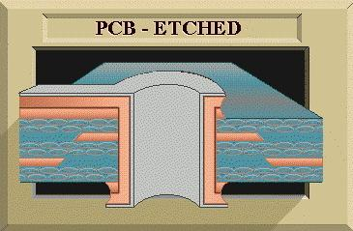
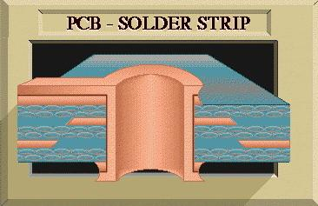
4 Layer PCB Example
Step 9 – Strip & Etch - we now strip the photo resist layer off of the core exposing the unwanted copper. - an etch is performed which removes all of the unwanted copper. - the copper circuitry is protected by the tin (or solder) and remains after the etch. - the entire surface is then stripped leaving only the desired pattern in copper.

Slide 34
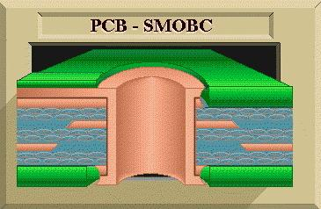
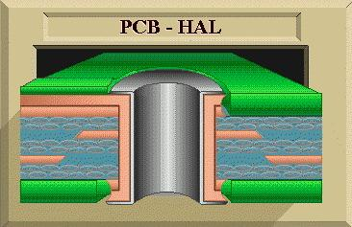
4 Layer PCB Example
Step 10 – Solder mask - now a solder mask is applied over the outer layers leaving openings for the pads to which components will be soldered. - “SMOBC” stands for “Solder Mask Over Bare Copper” and refers to a process in which the tin pattern plating was removed.
Step 11 – Surface Finish - now the pads are coated with a material that protects them from oxidation and allows them to be easily soldered to. - “HAL” stands for “Hot Air Surface Level” (aka HASL) and refers to a process of adding solder to the surface of the board using hot air to melt and blow the solder onto the pads. - a more modern process is called Emersion Silver and refers to dipping the board in Silver. This process is Lead-Free.

Slide 35
4 Layer PCB Example
Step 12 – Silk Screen - lastly, documentation is added to the outer layers of the boards.
Step 13 – De-panelization - if multiple images were fabricated on the same panel, then the boards are now routed into individual boars.
U1

Slide 36
PCB CAD
CAD = Computer Aided Drawing - a PCB CAD tool allows us to enter our design and ultimately produce information that a PCB Fab shop can use to create the PCB. - the files that the tool produces are called “Computer Aided Manufacturing (CAM) files. - the design flow for PCB CAD consists of: 1) Part Library Development - A library contains all of the parts in your design. Each part contains a schematic, a physical layout, and information about the vendor that can be used to create a “Build of Materials” 2) Schematic Entry - A schematic contains all of the part symbols and how they are connected. “Parts” will drive forward the pad configuration in the layout and “nets” will drive forward the traces and plane shapes. 3) Layout - A physical layout is then performed in which all of the parts are placed and connected with traces. 4) CAM - The final step is to create the Gerbers, Drill Files, and Drawings to be sent to the fab shop.

Slide 37
PCB CAD (GERBER)
GERBERs - in the PCB CAD tool, each design image is assigned a Layer - every metal layer will be assigned its own layer. - layers are numbered in ascending order from top to bottom (ex. L1, L2, L3, L4) - layers are also used to describe the top and bottom side Solder Mask - layers are also used to describe the top and bottom side Silk Screen - the CAM files from the CAD tool are produced in an industry standard format called GERBER - extensions for GERBERS can be *.GBR, *.PHO, *.ART (Mentor Pads uses *.PHO) - a GERBER file describes the image patterns that are present on that layer. - an “aperture” file is a way to describe to the photo plotting machines how to interpret the shapes described in the GERBER. NOTE: the term Gerber comes from a standard format for photo plotters published by the Gerber Systems Corporation in 1980.

Slide 38
PCB CAD (GERBER)
GERBERs - each layer in the design will produce its own GERBER file. Ex) for a 4 layer board, we will have: L1.pho L2.pho L3.pho L4.pho top_silk.pho top_mask.pho bottom_silk.pho bottom_mask.pho aperture_report.rep

Slide 39
PCB CAD (GERBER Example)
Example : GERBERS for a 4 layer PCB (Metal Layers) L1.pho L2.pho (this layer is a ground plane) L3.pho (this layer is a ground plane) L4.pho

Slide 40
PCB CAD (GERBER Example)
Example : GERBERS for a 4 layer PCB (Top Silk & Top Mask) L1.pho (shown again for reference)
top_mask.pho -note that this layer is negative, meaning that the shapes represents where mask will NOT be - note that every pad on L1 must have a solder mask opening so that components can make contact. top_silk.pho

Slide 41
PCB CAD (GERBER Example)
Example : GERBERS for a 4 layer PCB (Bottom Silk & Bottom Mask) L4.pho (shown again for reference)
bottom_mask.pho -note that this layer is negative, meaning that the shapes represents where mask will NOT be - note that every pad on L4 must have a solder mask opening so that components can make contact. bottom_silk.pho - this board didn’t have any silk screen on the bottom

Slide 42
PCB CAD (Drill Data)
Drill Data - information for drill sizes and locations are contained within a separate set of files. - these files are called “Numerically Controlled Drill (NCD) Files” or “Excellon” files. - the information in these files is a list of XY coordinates for where each drill hole will be made. Ex) for a 4 layer board done in Mentor PADS, we generate drill.drl : the NCD drill file that is read by the drilling machine drill.lst : a list of drill coordinates in a user-friendly format for manual checking drill.rep : a list of all drill sizes in a user-friendly format for manual checking

Slide 43
PCB CAD (Drill Data Example)
Example : Drill files for a 4 layer PCB drill.drl drill.lst drill.rep
%
T1C.008F0S0
X02345Y0105
X0231Y0105
X0231Y0109
X02345Y0109
X02345Y0113
X0231Y0113
X02345Y0117
X0231Y0117
X02345Y0233
X0231Y0233
X0231Y0237
X02345Y0237
X02345Y0241
X0231Y0241
X02345Y0245
:
Drill Listing
=============
Drill: .008 Tool: 1 Feed: 0 Speed: 0
X 234500 Y 105000
X 231000 Y 105000
X 231000 Y 109000
X 234500 Y 109000
X 234500 Y 113000
X 231000 Y 113000
X 234500 Y 117000
X 231000 Y 117000
X 234500 Y 233000
X 231000 Y 233000
X 231000 Y 237000
X 234500 Y 237000
X 234500 Y 241000
X 231000 Y 241000
:
Drill Sizes Report
==================
Tool Size Pltd Feed Speed Qty
==== ==== ==== ==== ===== ===
1 8 x 0 0 443
2 29 x 0 0 8
3 33 - 0 0 2
4 100 - 0 0 16

Slide 44
PCB CAD (Drill Data Example)
Example : Drill plot for a 4 layer PCB - we can plot our drill data over the top of our GERBERS in order to see if the holes line up to check that everything is accurate.

Slide 45
PCB CAD (Drawings)
Fab & Drill Drawings - in addition to the CAM files that you send to a PCB manufacturer, you also need to generate drawings so that the fab engineers can understand what you are trying to accomplish. - this provides an additional layer of checking. - there are two main types of drawing that accompany your CAM files: Fabrication Drawing - contains board outline dimensions - gives stackup dimensions, materials, surface finish - provides any special information about the board that the fab shop needs to know. Drill Drawing - contains a plot showing the location of each drill hole on the board - contains a drill table listing the different drill sizes and their quantity - a more common approach is to combine the two into a: Combined Drill/Fab Drawing

Slide 46
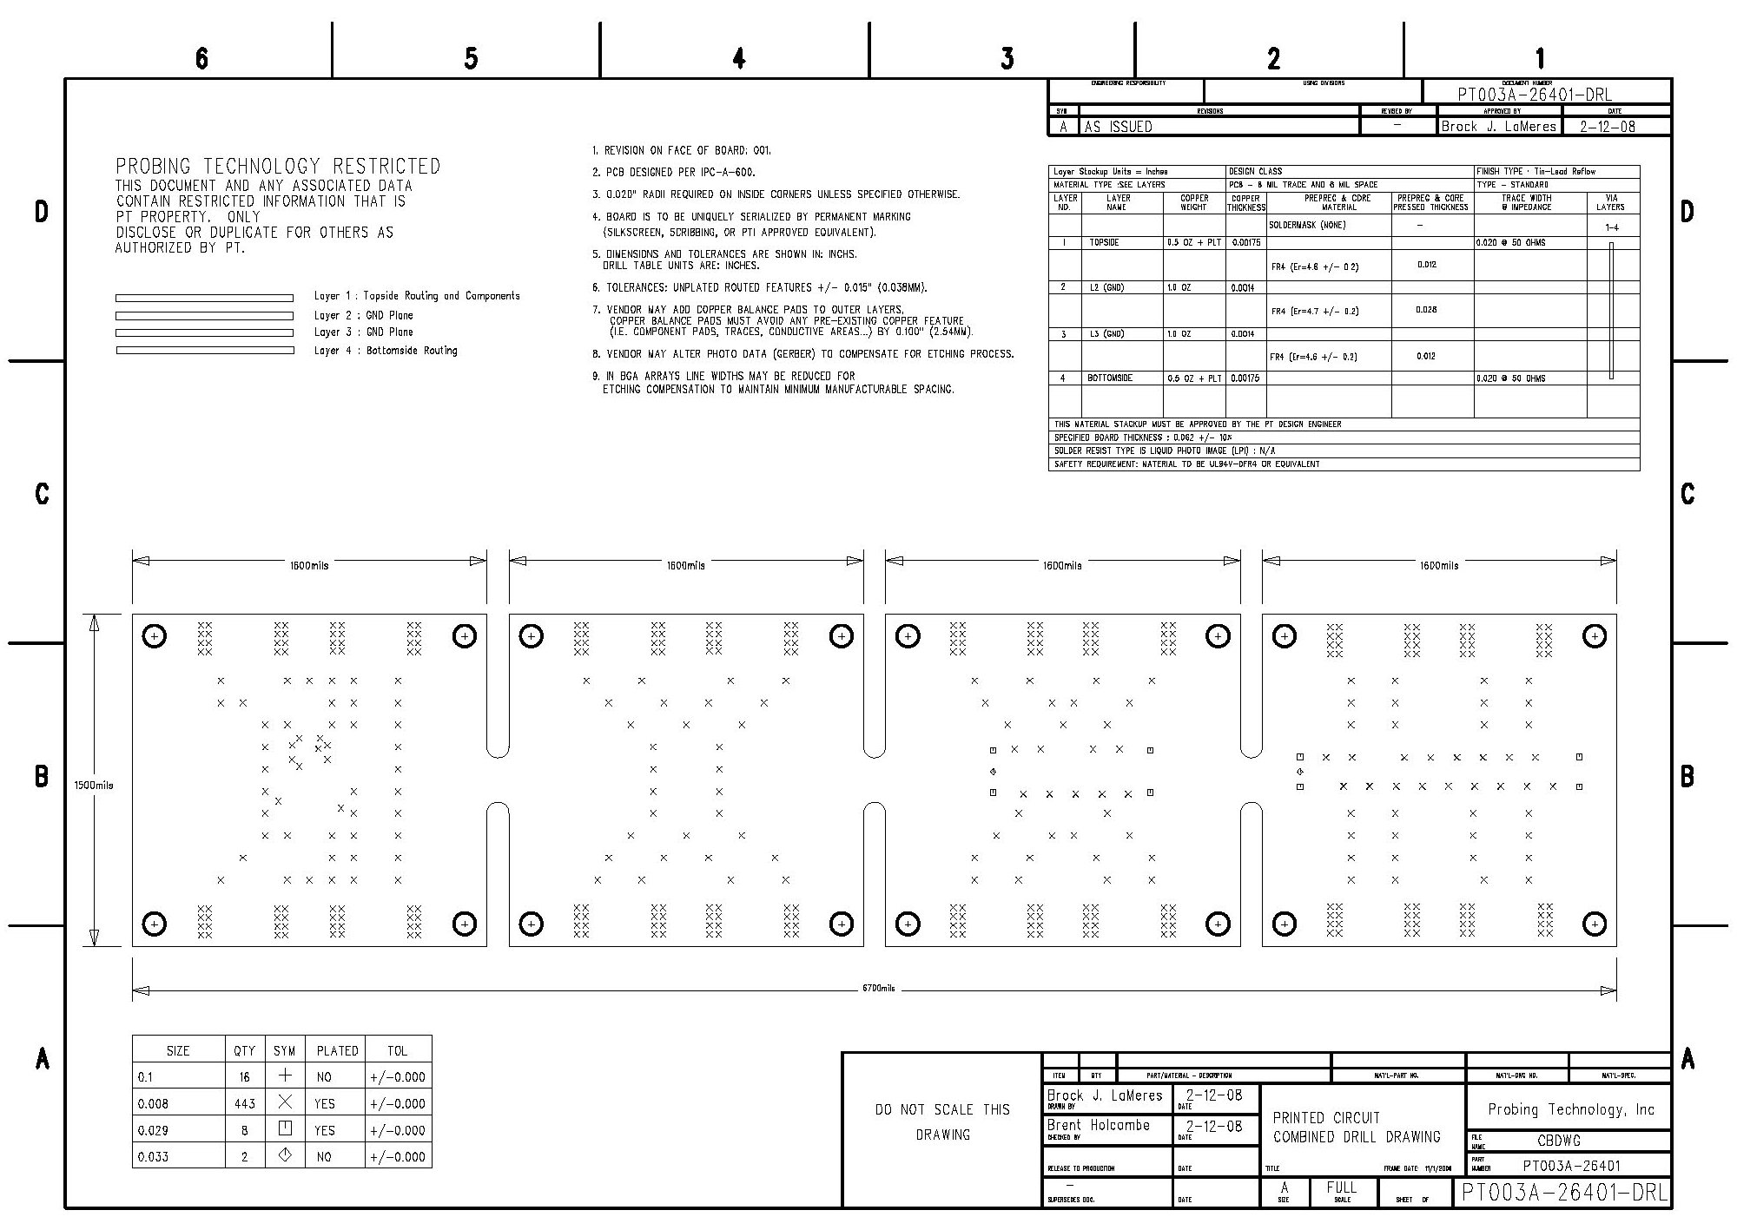
PCB CAD (Drawing Example)
Combined Fab/Drill Drawings
Special Notes about Board
Stackup, Material, and Surface Finish Information
Drill Locations
Board Dimensions
Drawing Border
Drill Table

Slide 47
PCB CAD (Example)
Final Result - The Gerber, Drill, and Drawing files were sent to a fab shop and 1 week later the PCB arrived.

Slide 48
Design for Manufacturability
Design for Manufacturability (DFM) - The physical sizes that we use in a PCB design are not arbitrary. - The minimum sizes and spacing are dictated by the Fabrication Vendor. - Prior to designing a PCB, you must look at the Design Rules for potential vendors and select the Design Rules that meet your application. - On a PCB, the smaller the features, the more circuitry that can fit on a board. - However, the smaller the feature, the higher the cost of the board. - In addition, when designing transmission lines, we select our material, widths, and spacing in order to achieve a characteristic impedance. Not necessarily the minimum geometry. - We are constantly trading off: Electrical Performance vs. Mechanical Performance vs. Cost

Slide 49
Design for Manufacturability
IPC - “Institute for Interconnecting and Packaging Electronic Circuits” - The organization that defines PCB standards. - PCB Fab vendors will typically adhere to a particular IPC standard. - This allows you to design your board using widths/spacing from an IPC standard that is independent of a PCB Fab vendor. - This way, your design can be sent to any Fab shop that supports that particular IPC standard. - IPC will work with a group of experts in the field and define the dimensions that can be achieved for a given standard. This way a standard is achievable by the majority of Fab Shops that are regularly improving their processes.

Slide 50
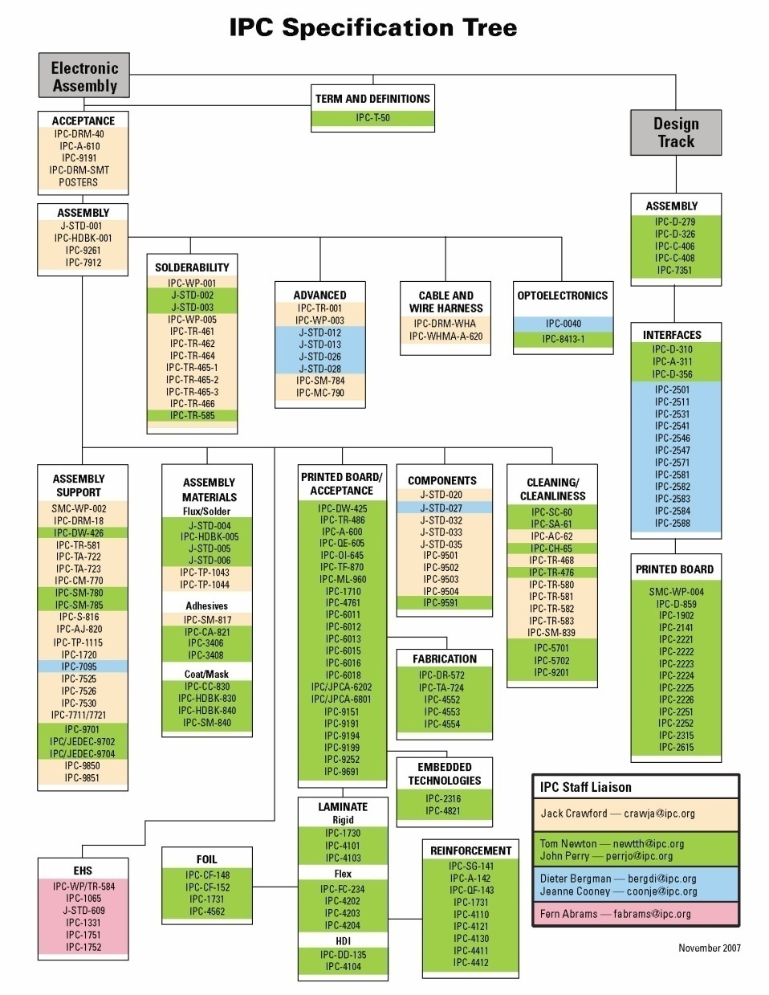
Design for Manufacturability
IPC - IPC specs all aspects of electronic interconnect (PCB, Assembly, Materials, etc.) - The dimensions we are interested in are found in the “Printed Board / Acceptance” section:

Slide 51
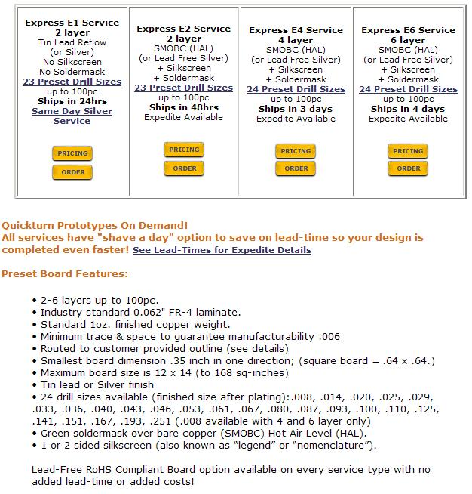
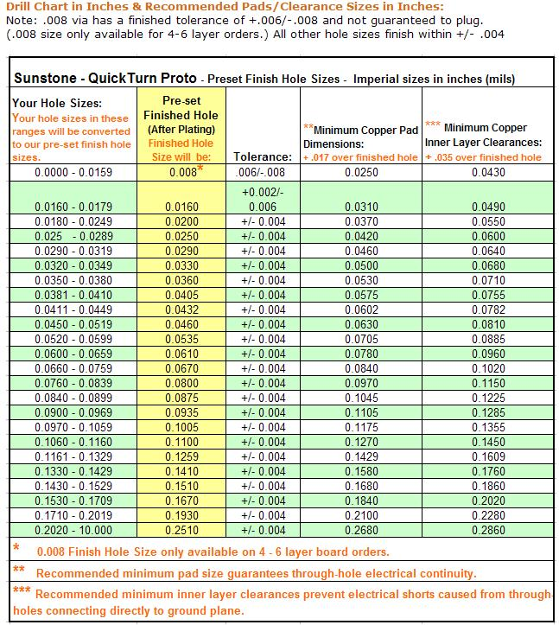
Design for Manufacturability
Vendor Specific Capabilities - here is an example of specifications from PCBexpress.com

Slide 52
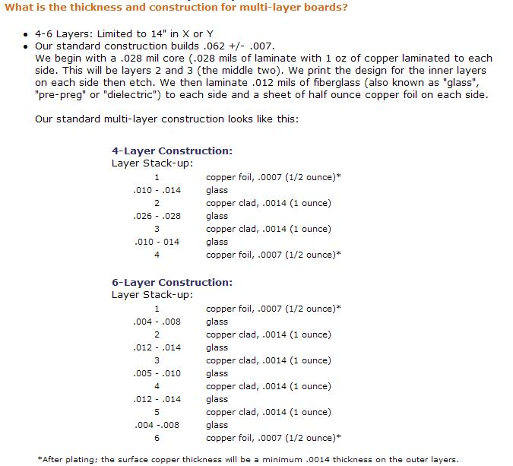
Design for Manufacturability
Vendor Specific Capabilities (PCBexpress.com cont…) - notice that we can use trace widths as small as 0.006” - however, if we want to design a 50 ohm transmission line (i.e., a microstrip or stripline) we need to look at the stackup and materials in order to choose a width that gives us our desired impedance.

Slide 53
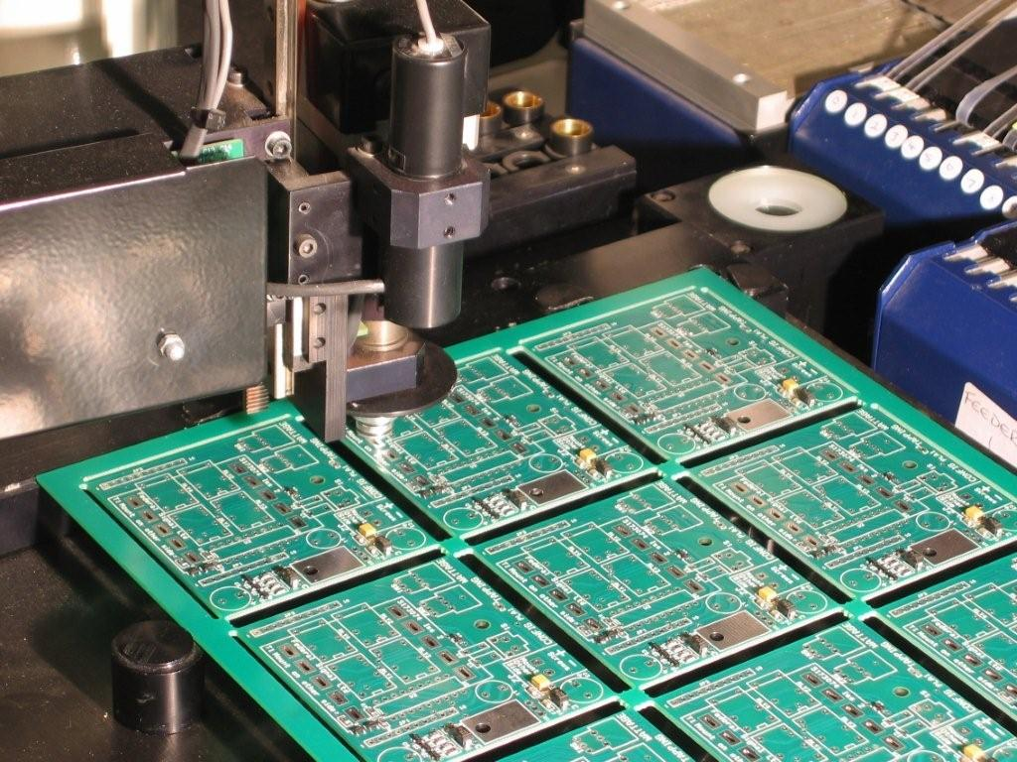
Component Loading
Loading - in high volumes, PCBs are loaded using automatic assembly machines. - this is typically called “Pick and Place” which refers to the robotic arms picking up a component from a bin of parts and placing it on the PCB.

Slide 54
Through-Hole Component Loading
Through Hole - Through-Hole Technology refers to components that have leads that extend all the way through the PCB. - When designing a PCB, a plated through-hole is created that is large enough to accept the leads of the part. - The leads of the part are then inserted into the holes. - The entire board is then ran through a Wave Soldering process which applies solder to the backside of the board. - The leads are then trimmed from the backside of the board.

Slide 55
SMT Component Loading
Surface Mount Technology - SMT refers to components that only contact the surface of the board. - this allows components to be loaded without having to drill holes in the board. - this allows much smaller components to be used. - SMT technology can be used on both the top and bottom of the PCB (i.e., doubled sided PCAs)

Slide 56
SMT Component Loading
Solder Paste - the first step in using automated SMT assembly is to apply solder paste. - solder paste is a mixture of solder and flux. - flux is an acid solution that eats through oxidation. - by mixing solder and flux together, a thick, viscous material is create (about the same viscosity as toothpaste). - this material is called solder paste and has some attractive properties: 1) It can be applied to the pads of a PCB using a stencil since it is viscous 2) It contains flux so any oxidation on the pads will be eliminated 3) If a component is placed on the flux, the component will stick. The solder paste is sticky enough so that a PCB can be turned upside down and the components will not fall off. - The entire board is then heated up in a reflow oven. This burns the flux out of the paste leaving only molten solder. When the board is cooled, a solid solder joint is formed.

Slide 57
SMT Component Loading
Solder Paste - if a board is to be loaded using automated SMT pick and place technology, the CAD tool must produce data for the paste stencil. top_paste.pho bottom_paste.pho ex) L1.pho top_paste.pho

Slide 58
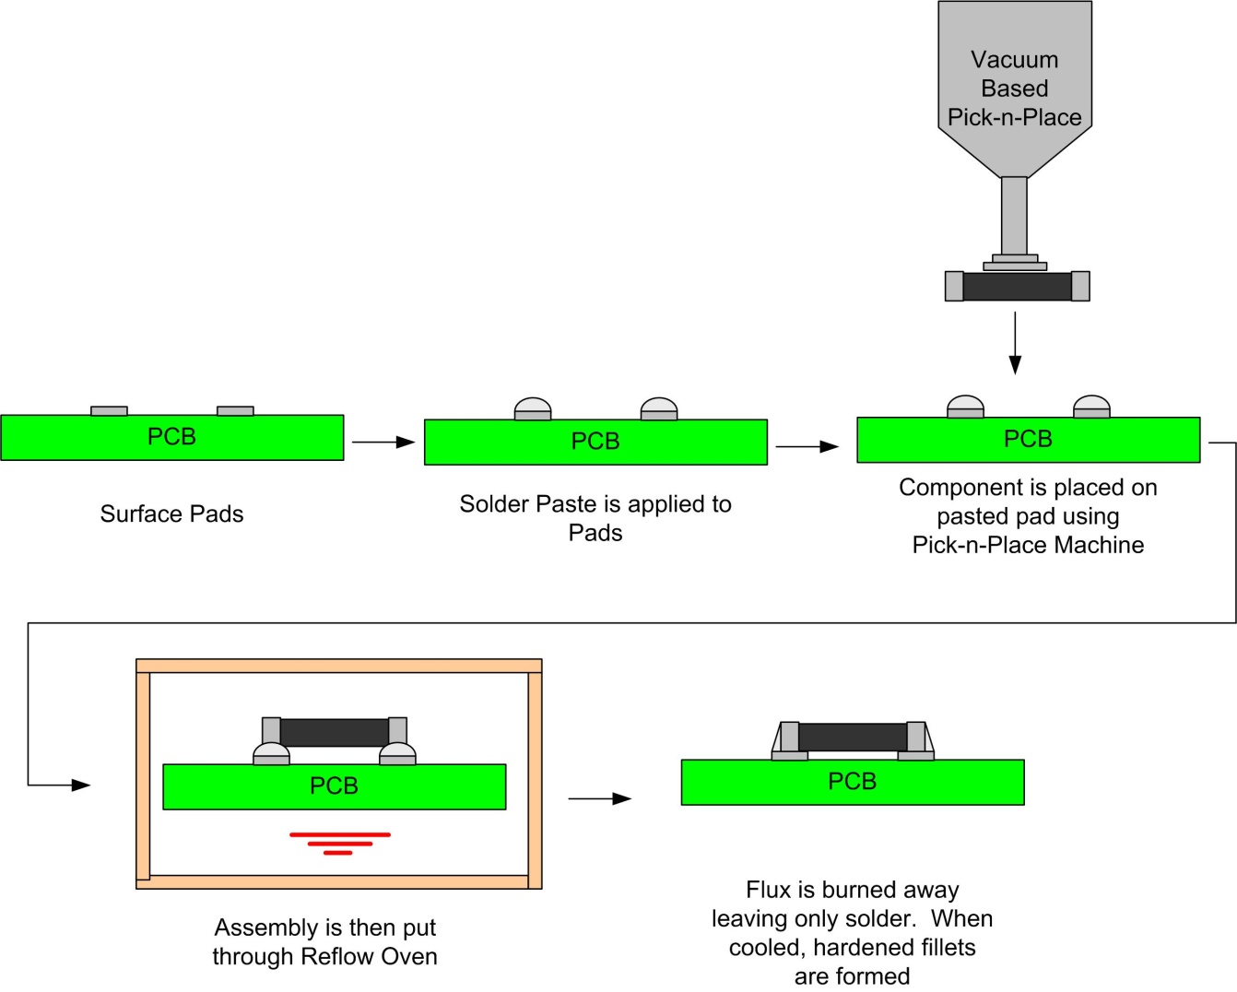
SMT Component Loading
SMT Process

Slide 59
PCB Transmission Lines
Transmission Lines - We’ve seen that a transmission line is described in terms of Impedance and Prop Delay - We’ve also seen that the Characteristic Impedance and Prop Delay are only functions of the inductance and capacitance of the line: - Inductance and capacitance are frequency independent and functions of the structure geometries and materials. - This means that for a transmission line, Z₀ and T_{D} are only dependent on the physical shape and material properties. - We use the term Controlled Impedance to describe T-line structures where we define a geometry in which we know exactly where the signal and return current propogate.

Slide 60
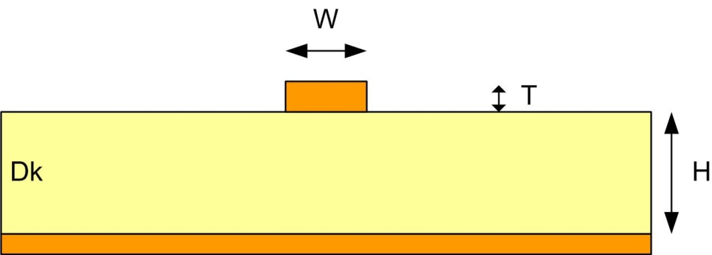
PCB Transmission Lines
Microstrip - A microstrip transmission line consists of a signal trace residing over an infinite ground plane. - On a PCB, these transmission lines exist when you use the outer layers for signal traces and then put a plane beneath (typically directly beneath, L2) - The return path is the ground plane beneath the trace. - NOTE: There are two important things to notice about a Microstrip: 1) The field lines are NOT completely contained within a homogenous medium so there is no FEXT canceling. 2) The field lines extend upward from the signal trace and can coupled to adjacent boards.

Slide 61
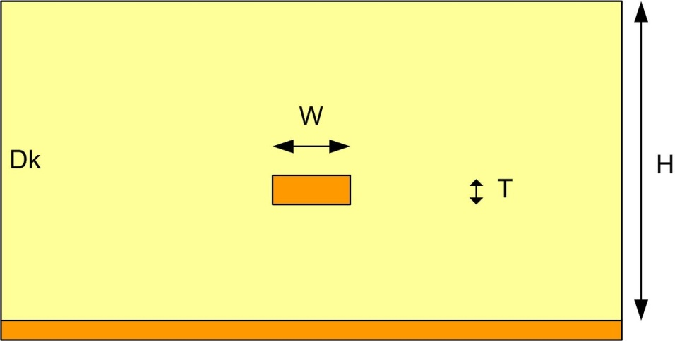
PCB Transmission Lines
Embedded Microstrip - This is simply a microstrip that is buried within the dielectric. - This type of structure attempts to contain all of the field lines within the same dielectric material.

Slide 62
PCB Transmission Lines
Stripline - A stripline transmission line consists of a signal trace sandwiched between two return planes - On a PCB, these transmission lines exist on inner layers if you are able to put planes above and beneath the signal layer (typically requires at least 6 layers) - The return path is split between the two ground planes. - NOTE: There are two important things to notice about a Stripline: 1) The field lines ARE completely contained within a homogenous medium so there is FEXT canceling. 2) The field lines are strongly coupled to the two ground planes so coupling to adjacent neighbors is minimized.
Symmetric Stripline
Asymmetric Stripline

Slide 63
PCB Transmission Lines
Coplanar - A coplanar transmission line uses the same metal layer of the PCB for both the signal and return. - this is commonly used on PCB’s with very few layers.

Slide 64
Signal Integrity on PCBs
Impedance Discontinuities in PCB’s - sources of impedance discontinuities on PCB’s 1) Vias (typically larger than the traces we use) 2) Pads (typically larger than the traces we use) 3) Cross-talk (coupling to other traces causes Z₀ to change) 4) Return Path (switch routing layers also requires a change in the return path) 5) Dk variance (Dk can change from one region of the board to another) 6) Etching Tolerance (Trace widths will have tolerances, +/-x%, that changes Z₀) 7) Etching Variance (Trace widths can change due to etching variance across the board) 8) Plating Variance (The thickness of a trace can chance across the board due to plating) 9) Thickness Variance (The lamination may result in different board thicknesses vs. location) - each of these noise sources must be analyzed in the noise budget.

